Slide 1
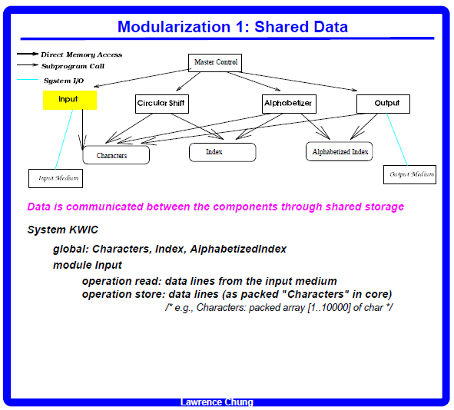

Slide 2
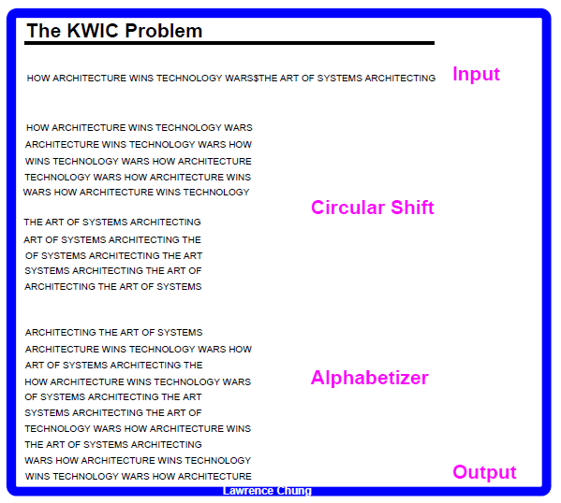

Slide 3
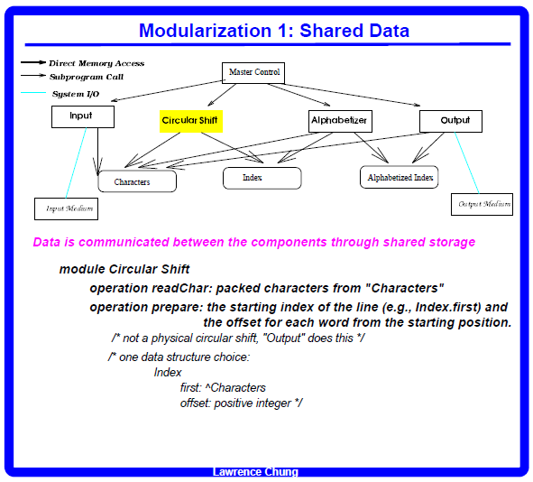

Slide 4
. Huffman coding
a Huffman code is a particular type of optimal prefix code that is commonly used for lossless data compression,
Char | Freq | Code
space | 7 | 111
a | 4 | 010
e | 4 | 000
f | 3 | 1101
h | 2 | 1010
i | 2 | 1000
m | 2 | 0111
n | 2 | 0010
s | 2 | 1011
t | 2 | 0110
l | 1 | 11001
o | 1 | 00110
p | 1 | 10011
r | 1 | 11000
u | 1 | 00111
x | 1 | 10010

Slide 5
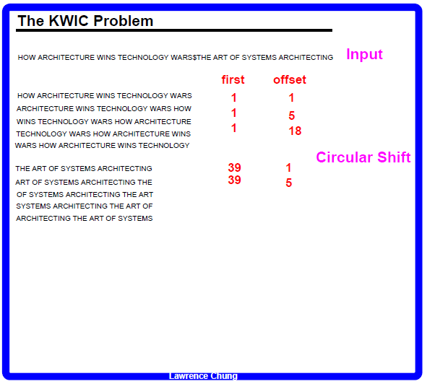

Slide 6
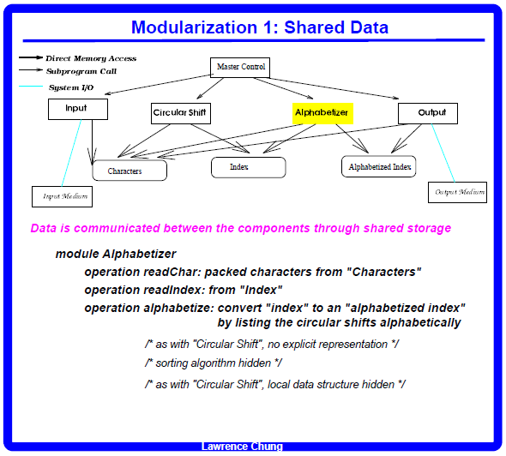

Slide 7
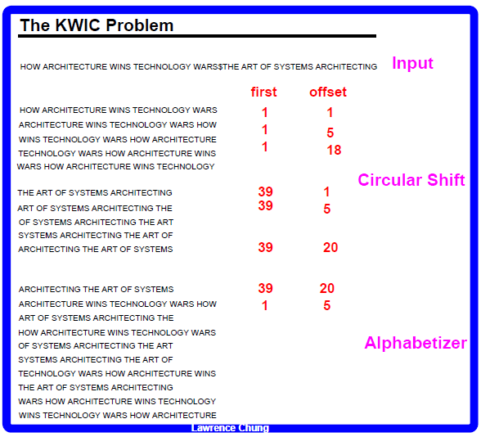

Slide 8
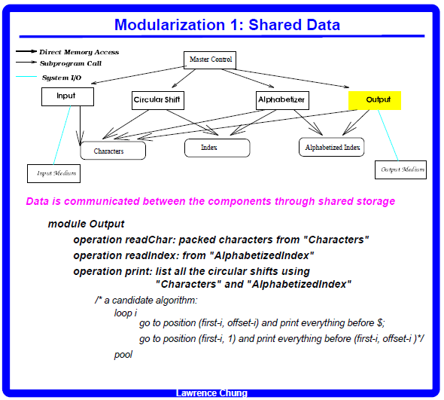

Slide 9
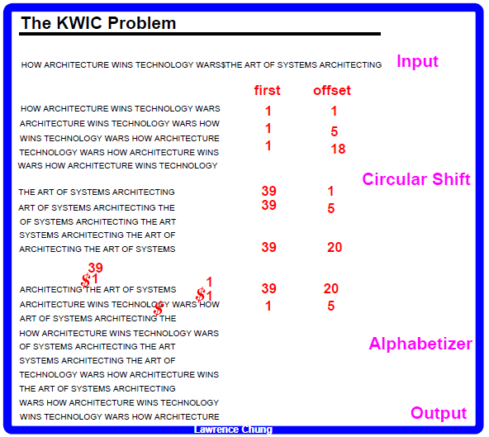

Slide 10
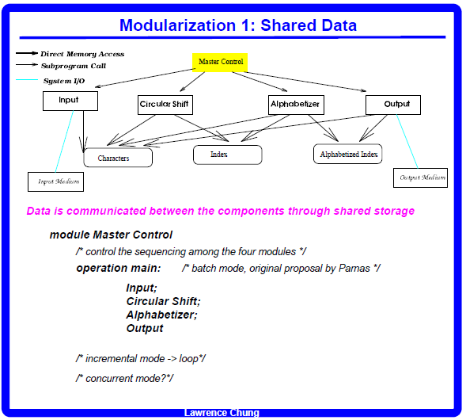

Slide 11
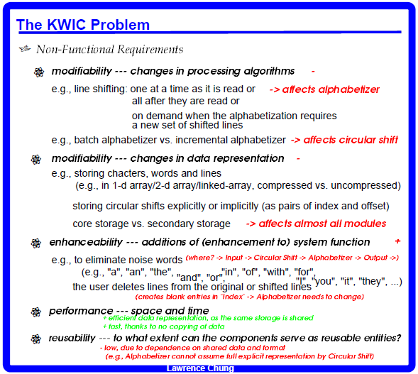

Slide 12
